Slide 1
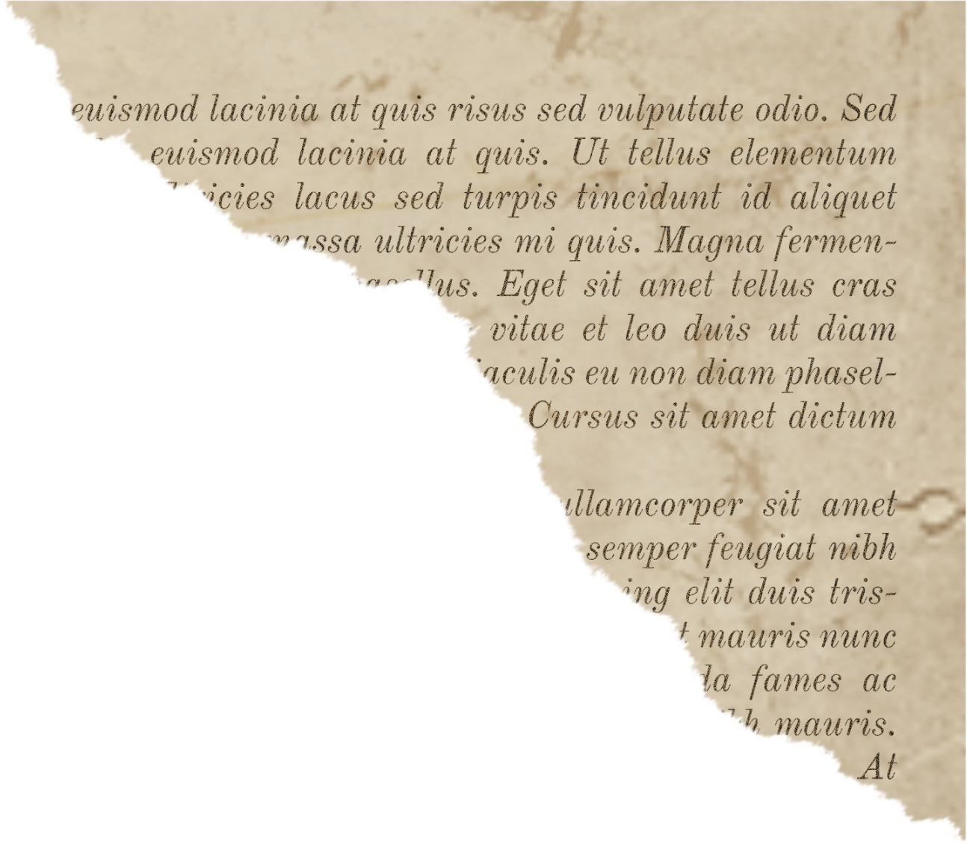


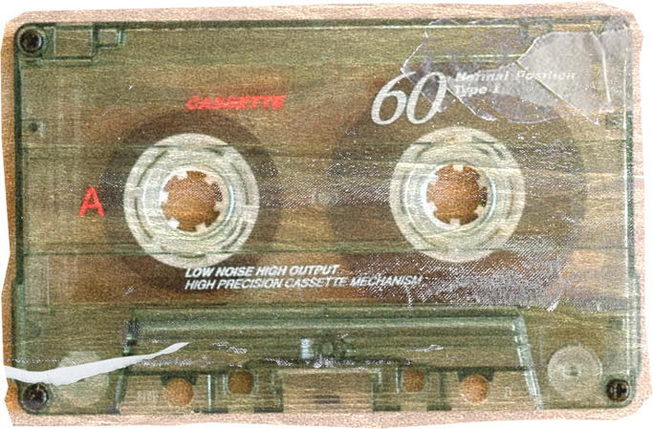

Memosac
Transforming Moments into Timeless Keepsakes
Pearl 2210990648
Prachi Malik 2210990661
Prachi Anand 2210990660
Guransh Singh 2210990335

Slide 2






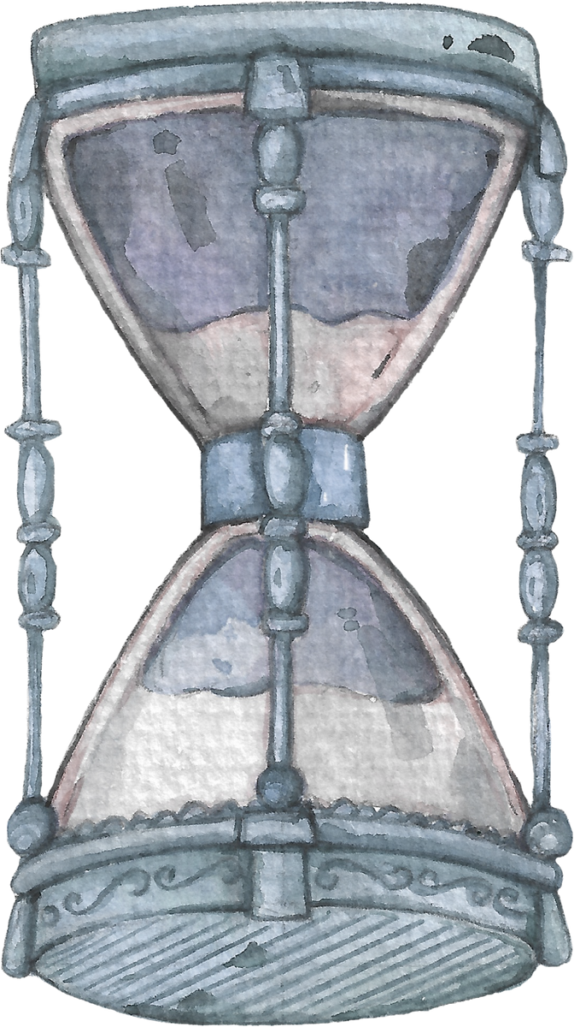
ntroduction
A secure platform to preserve your family memories

Slide 3




Problem Statement
Data Loss
Security Concerns
Disorganization

Slide 4






Realiable Preservation
Effective Manangement
Enhanced Security
Need for a solution

Slide 5

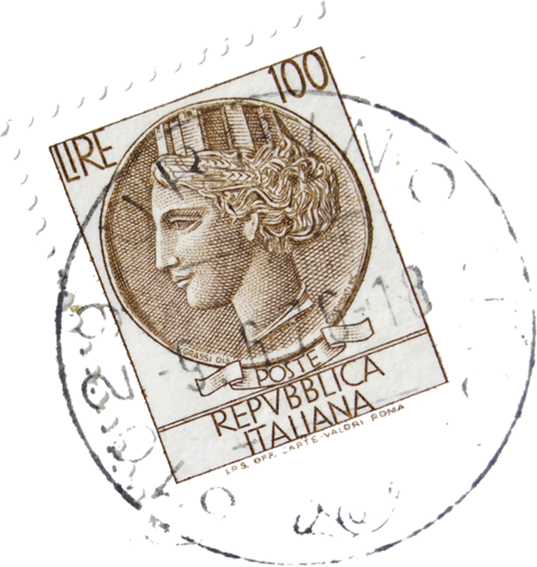
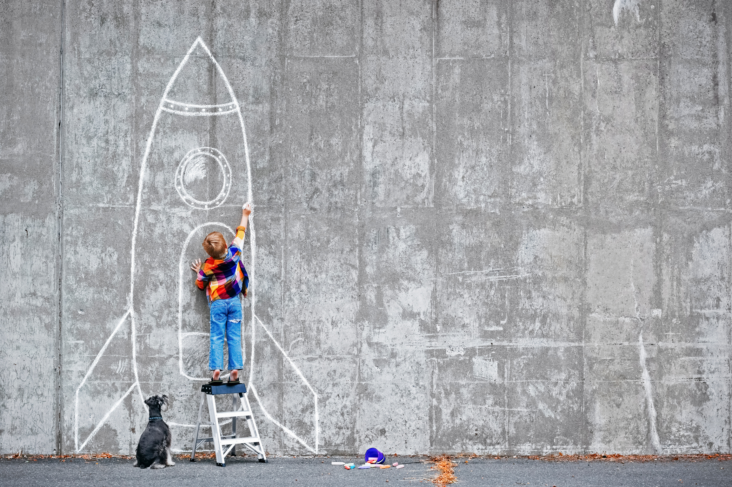

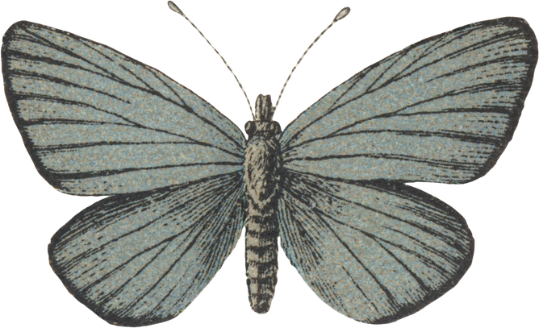
Memosac

Slide 6

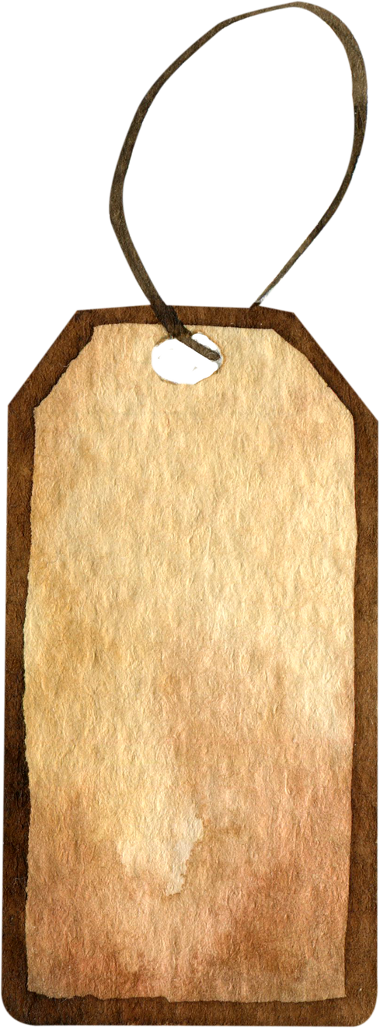

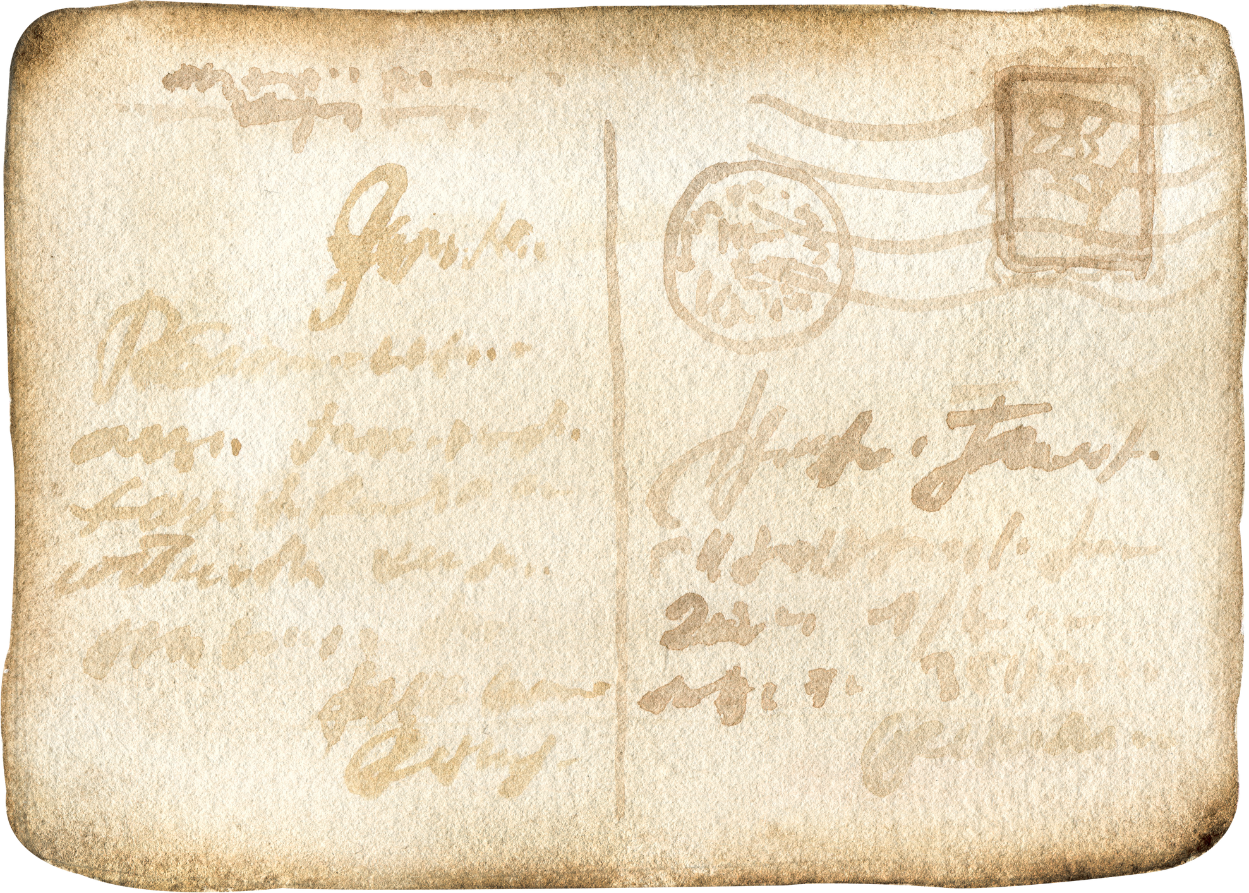
Platform | Memory Preservation | Privacy-Focused
Memosac | High | High
Google Photos | Medium | Medium
Dropbox | Medium | Medium
Ancestry.com | Low | Medium
Facebook | Low | Low
Market
Competitors

Slide 7




Features Of Memosac
Blogging
Blog Index Page
User Authentication
Online Gallery

Slide 8





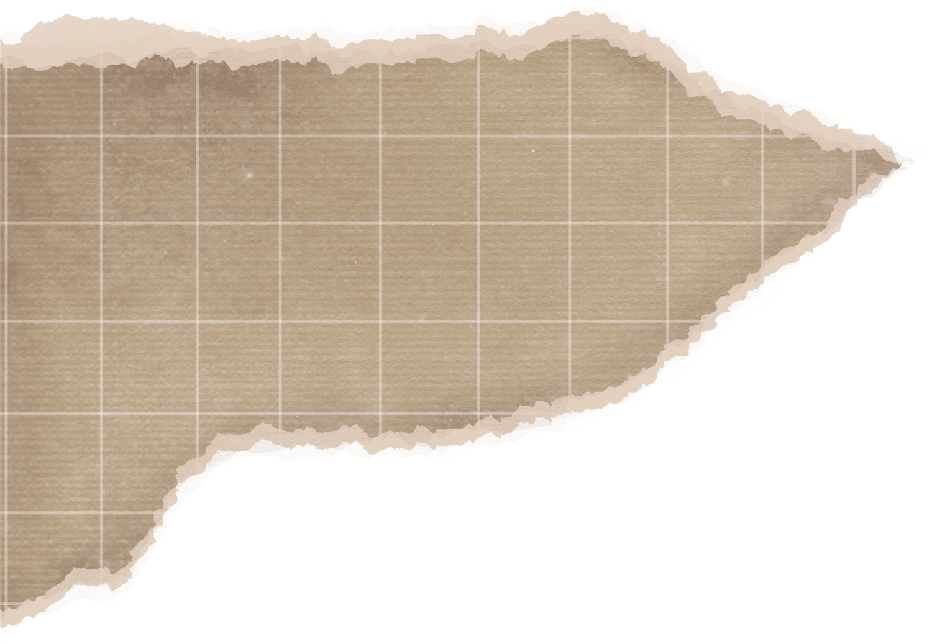
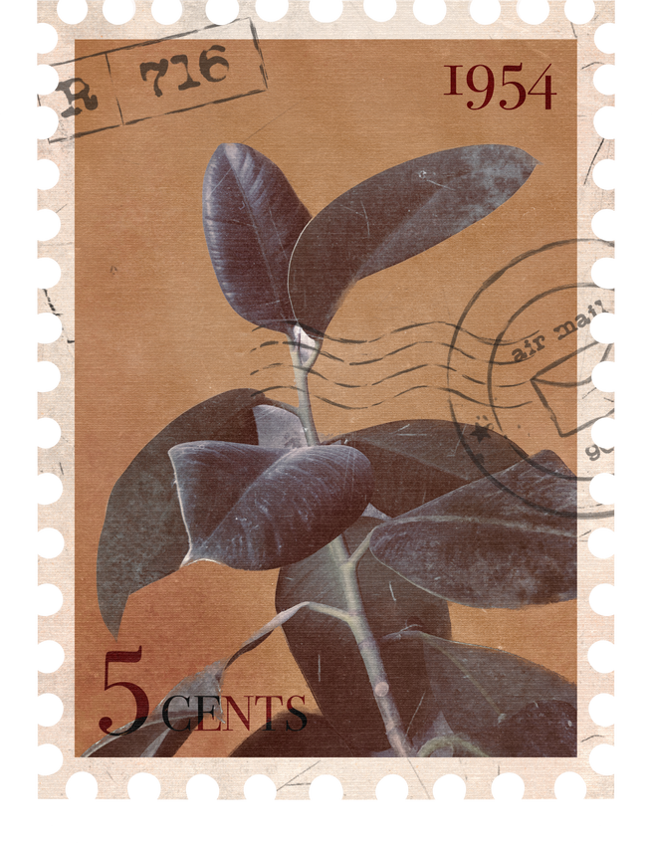
Sneak-a-Peek in Memosac

Slide 9

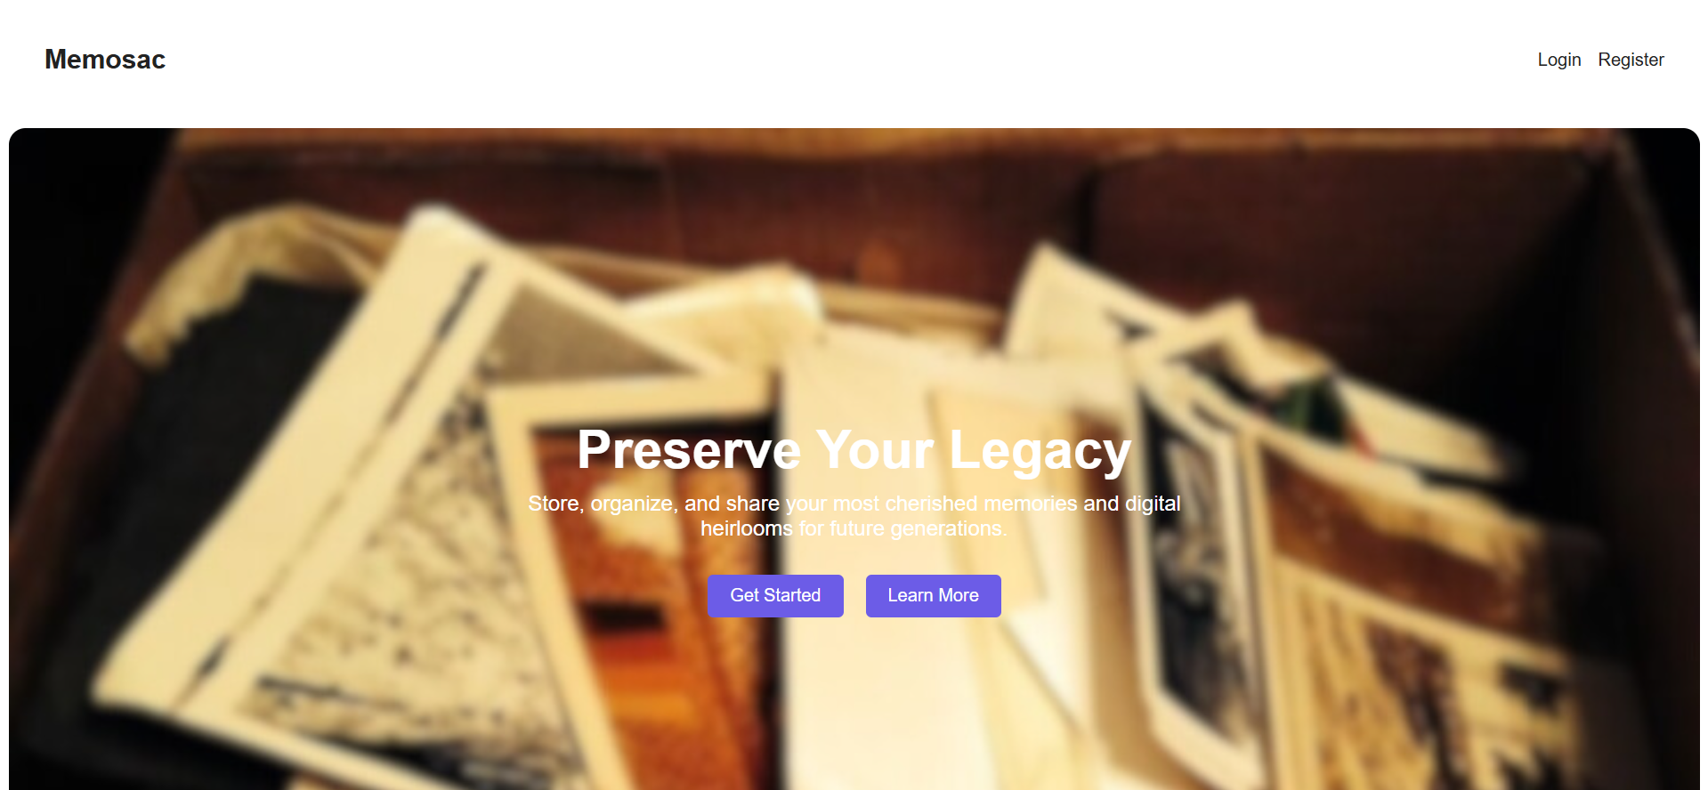
HomePage

Slide 10
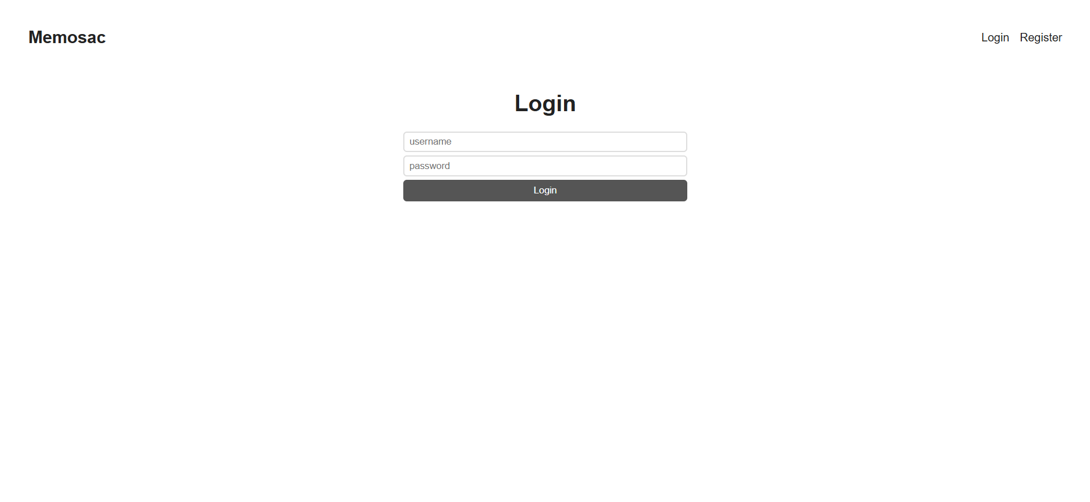
Login Page

Slide 11
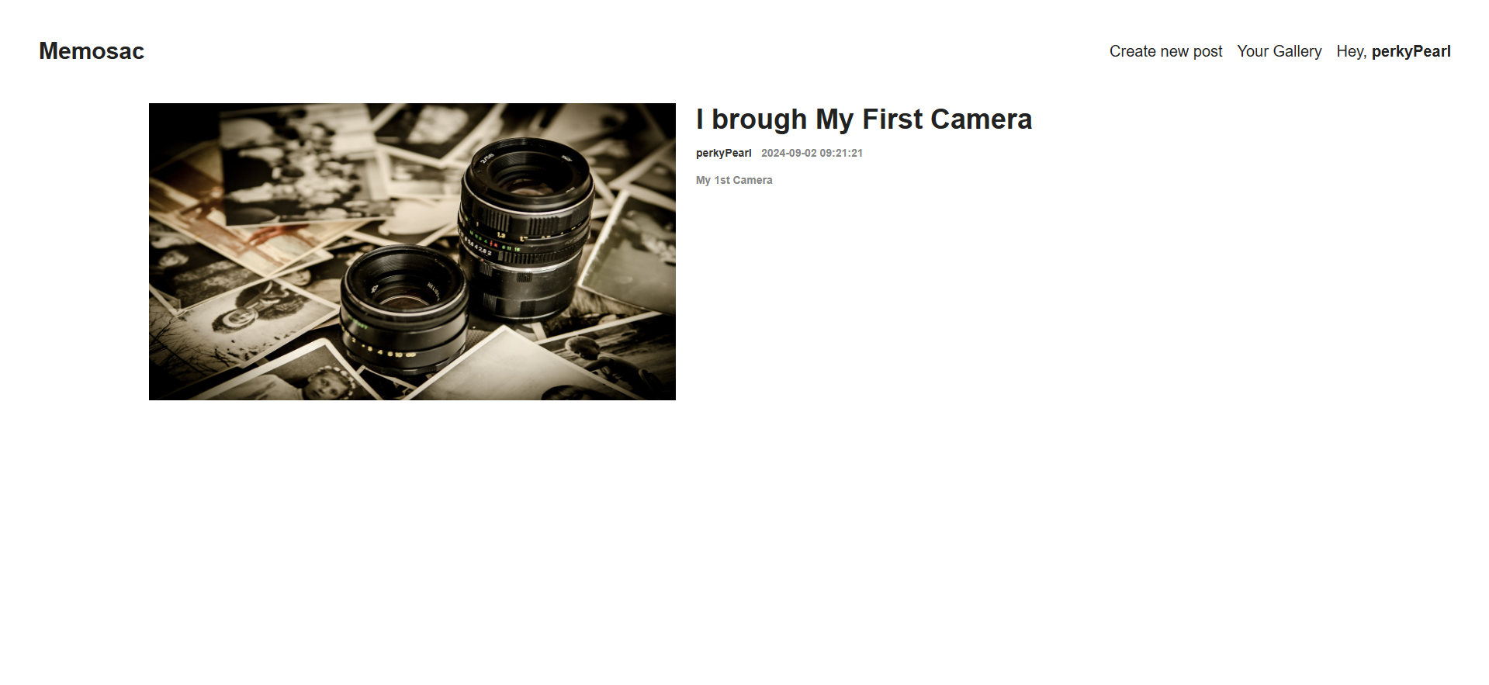
Blog Homepage

Slide 12
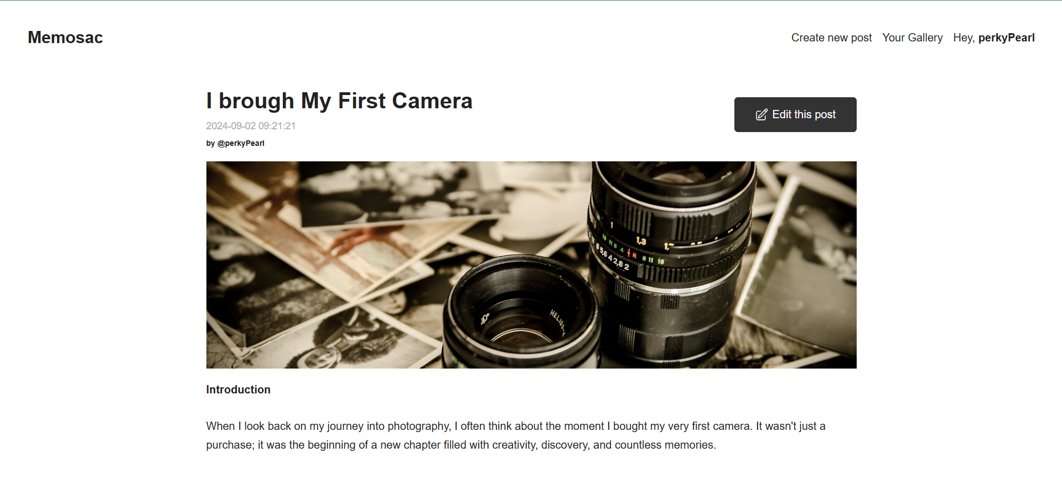


Blog Page
Only author can see “Edit” button

Slide 13
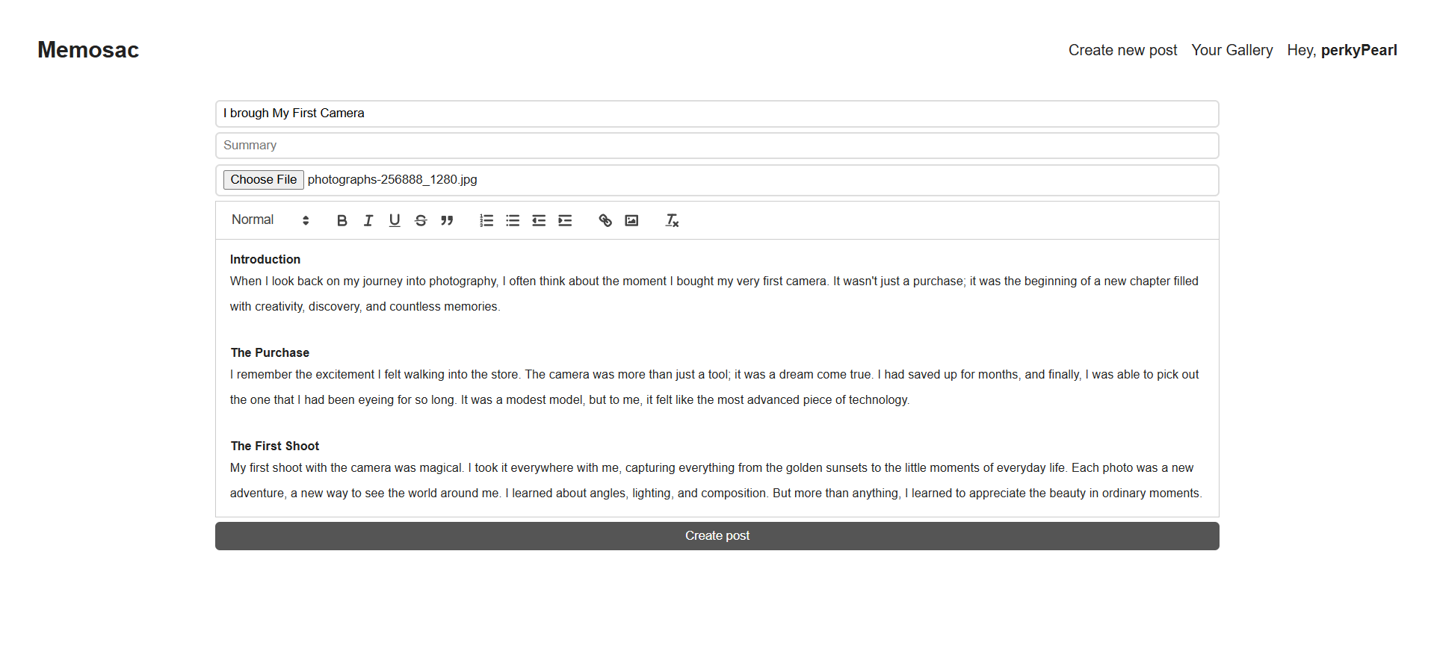
Blog Posting Page

Slide 14
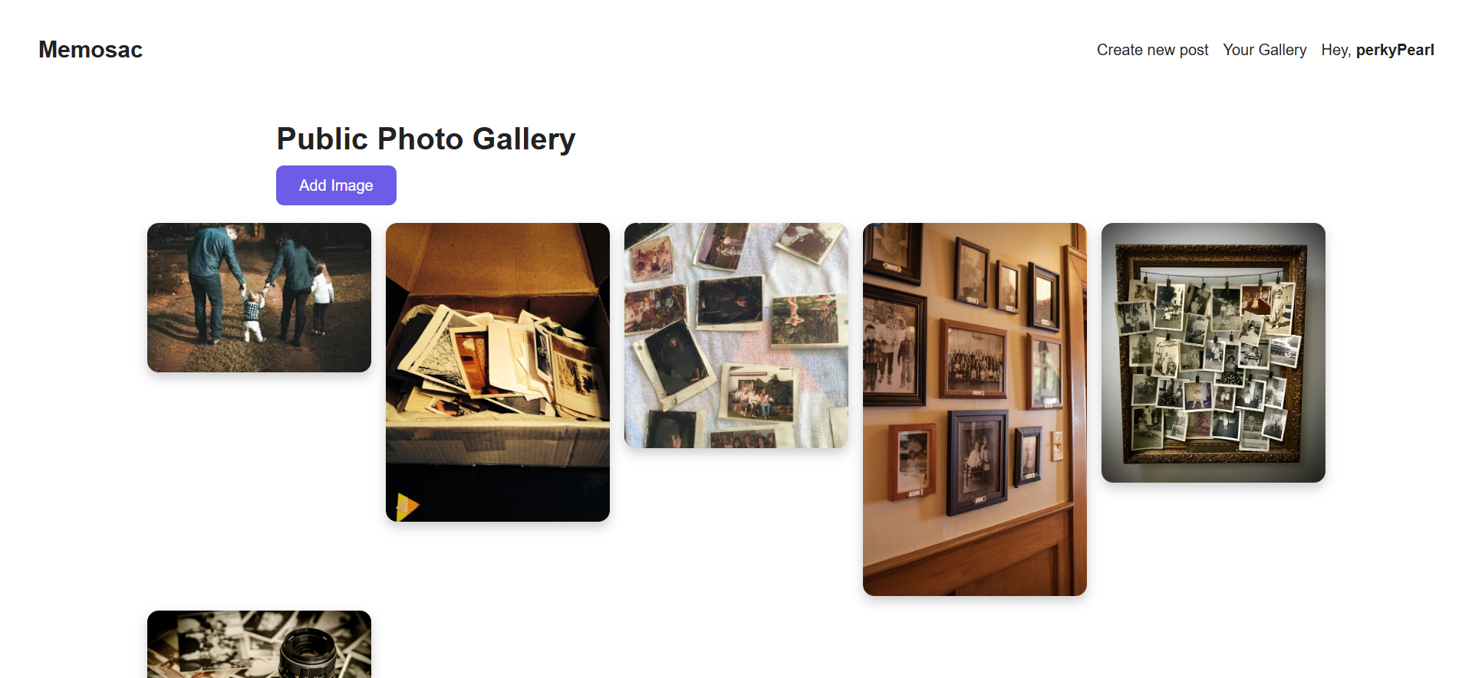
Gallery Page

Slide 15




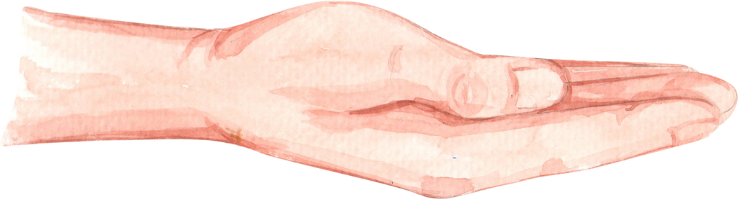
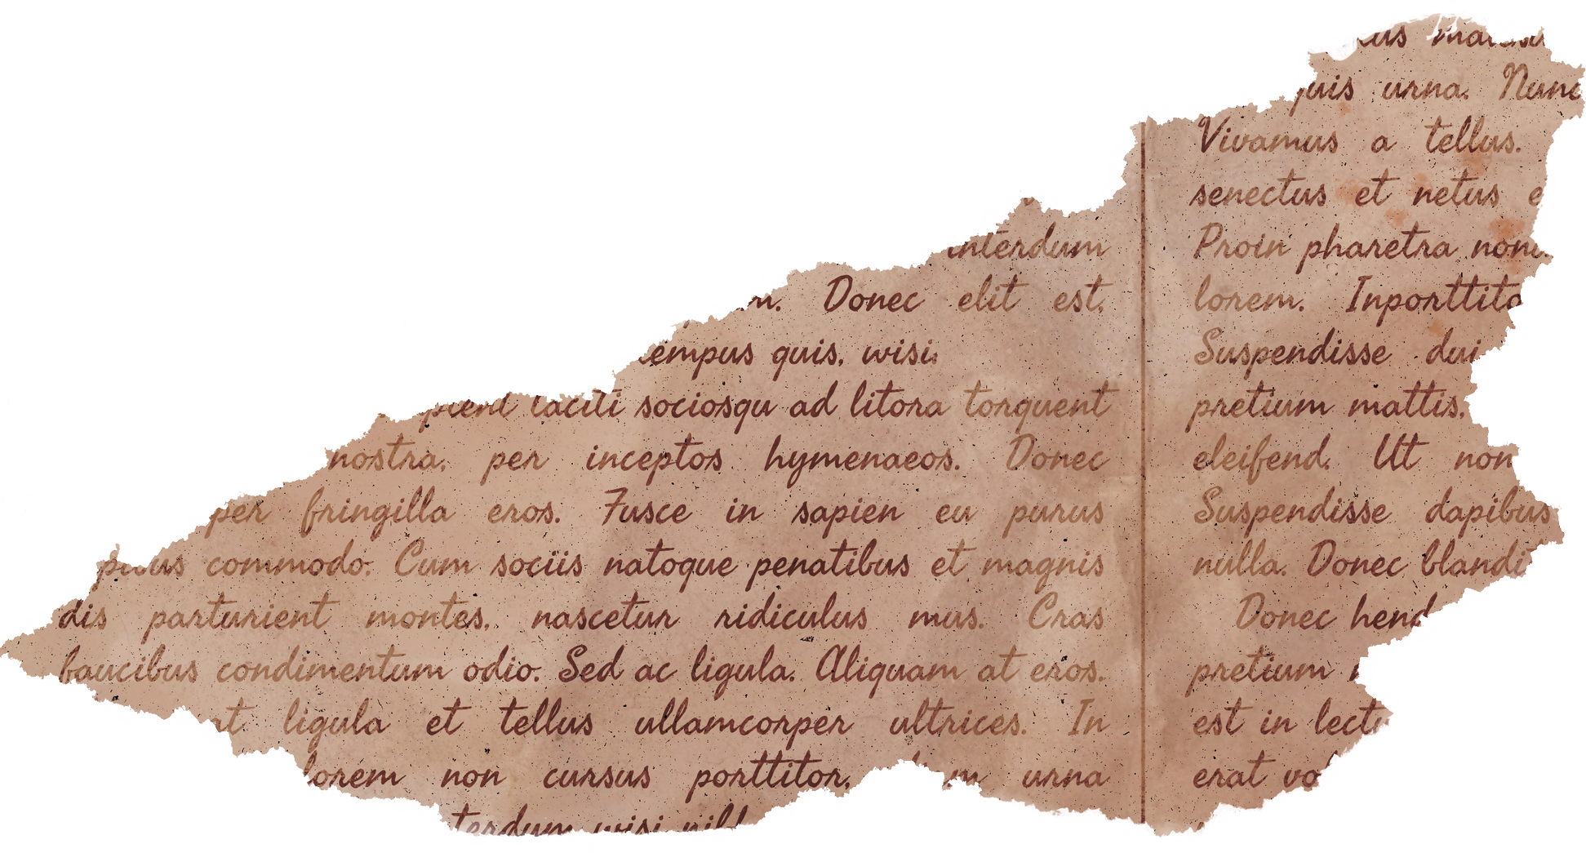
Upcoming Features
Categorization & Searching/Filtering
Multimedia Support
Collaborative Albums
Time Capsuling and Story Telling
Notification & Reminders

Slide 16
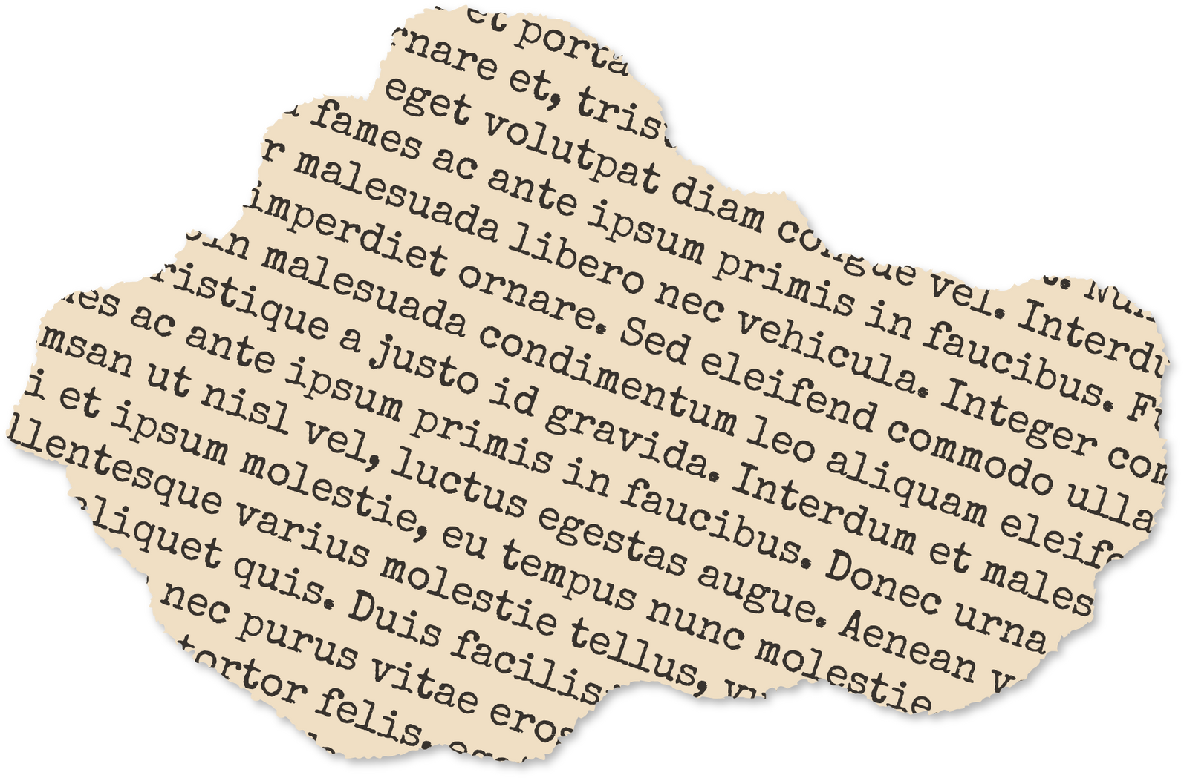
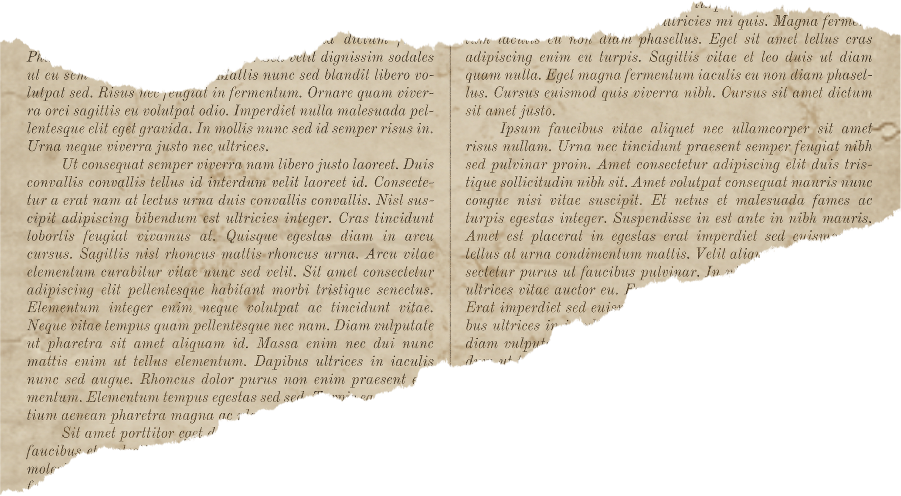






Thank You!

